Slide 1
Plan for today
1- Update to matrix_spatiotemporal
2- Numerator and denominator matrices – Fixed!
3- Patience to get better mosaics

Slide 2
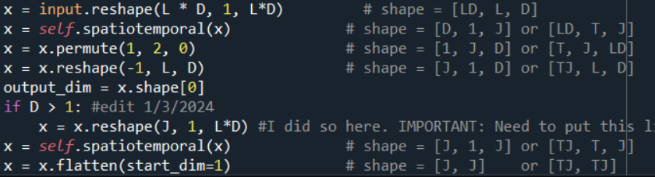

What the hell does this do?

Slide 3
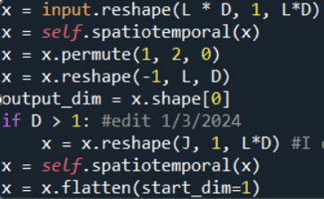

Cleaned up a bit
->

Slide 4
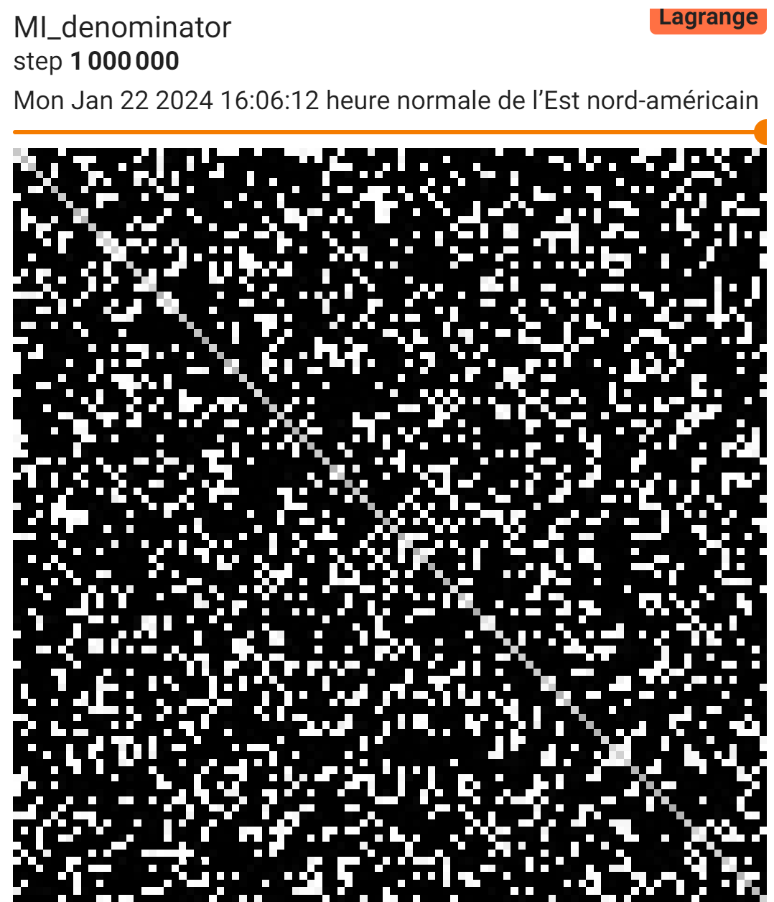
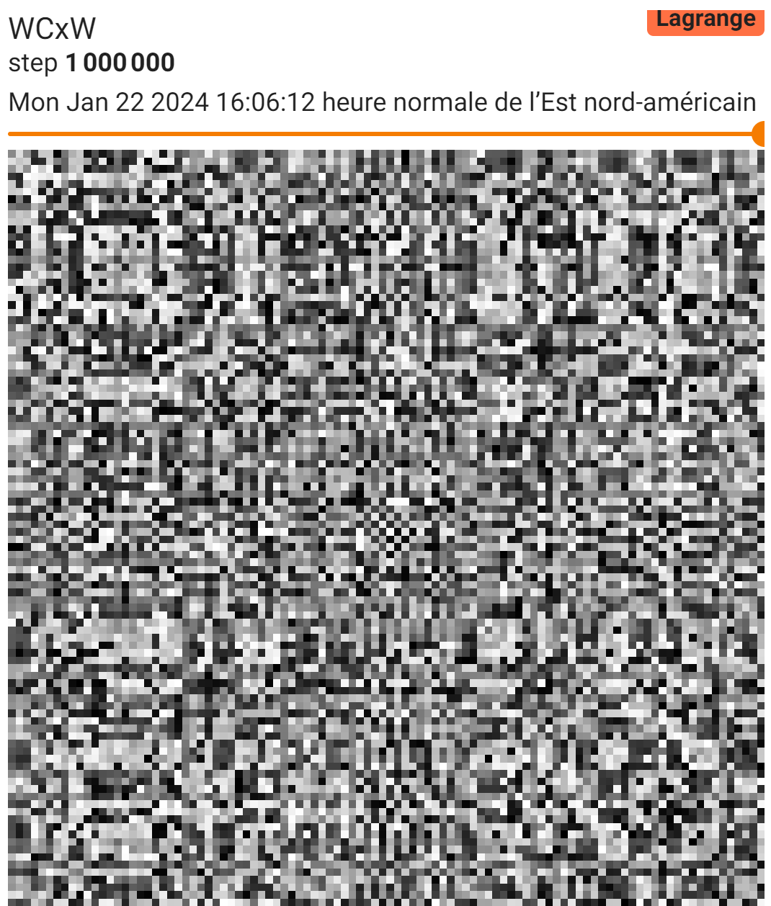
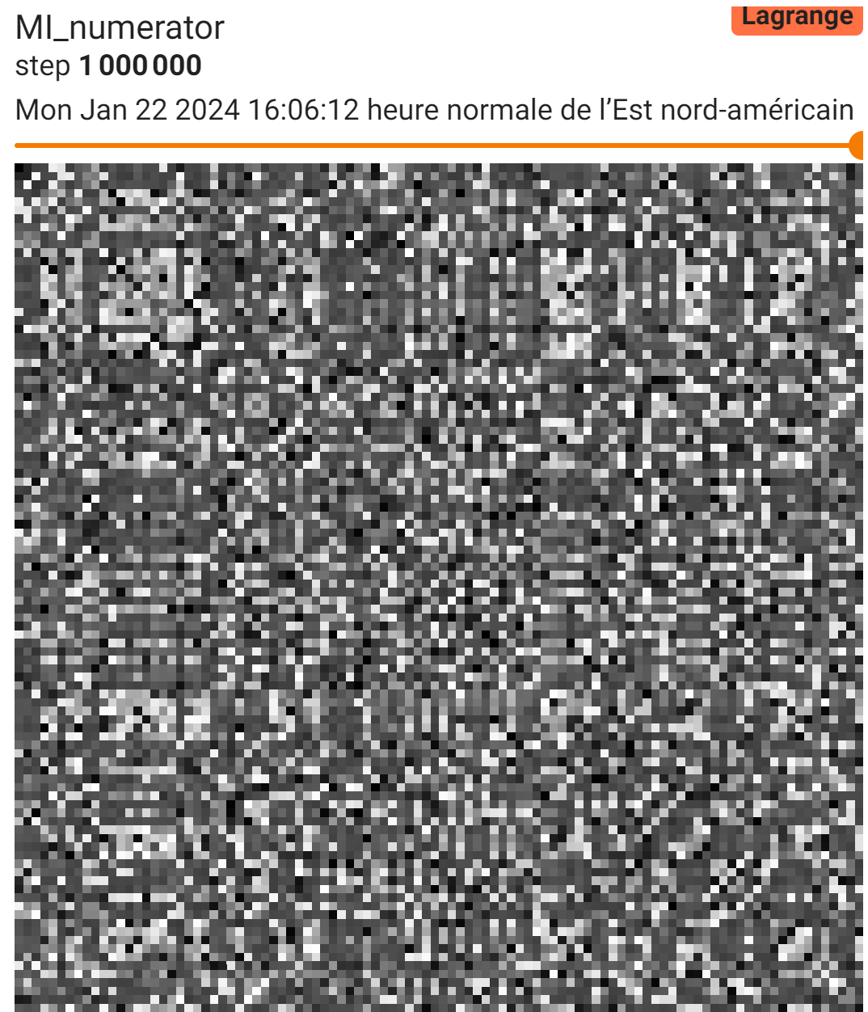
Numerator and denominator matrices were weird last week

Slide 5
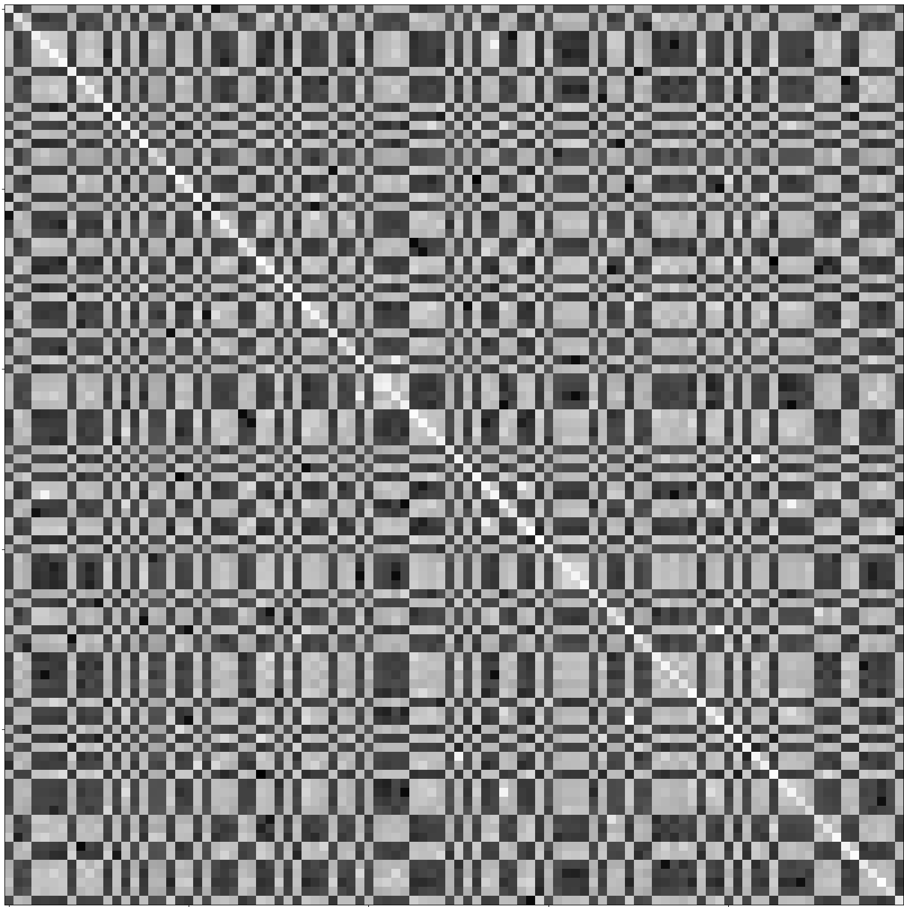
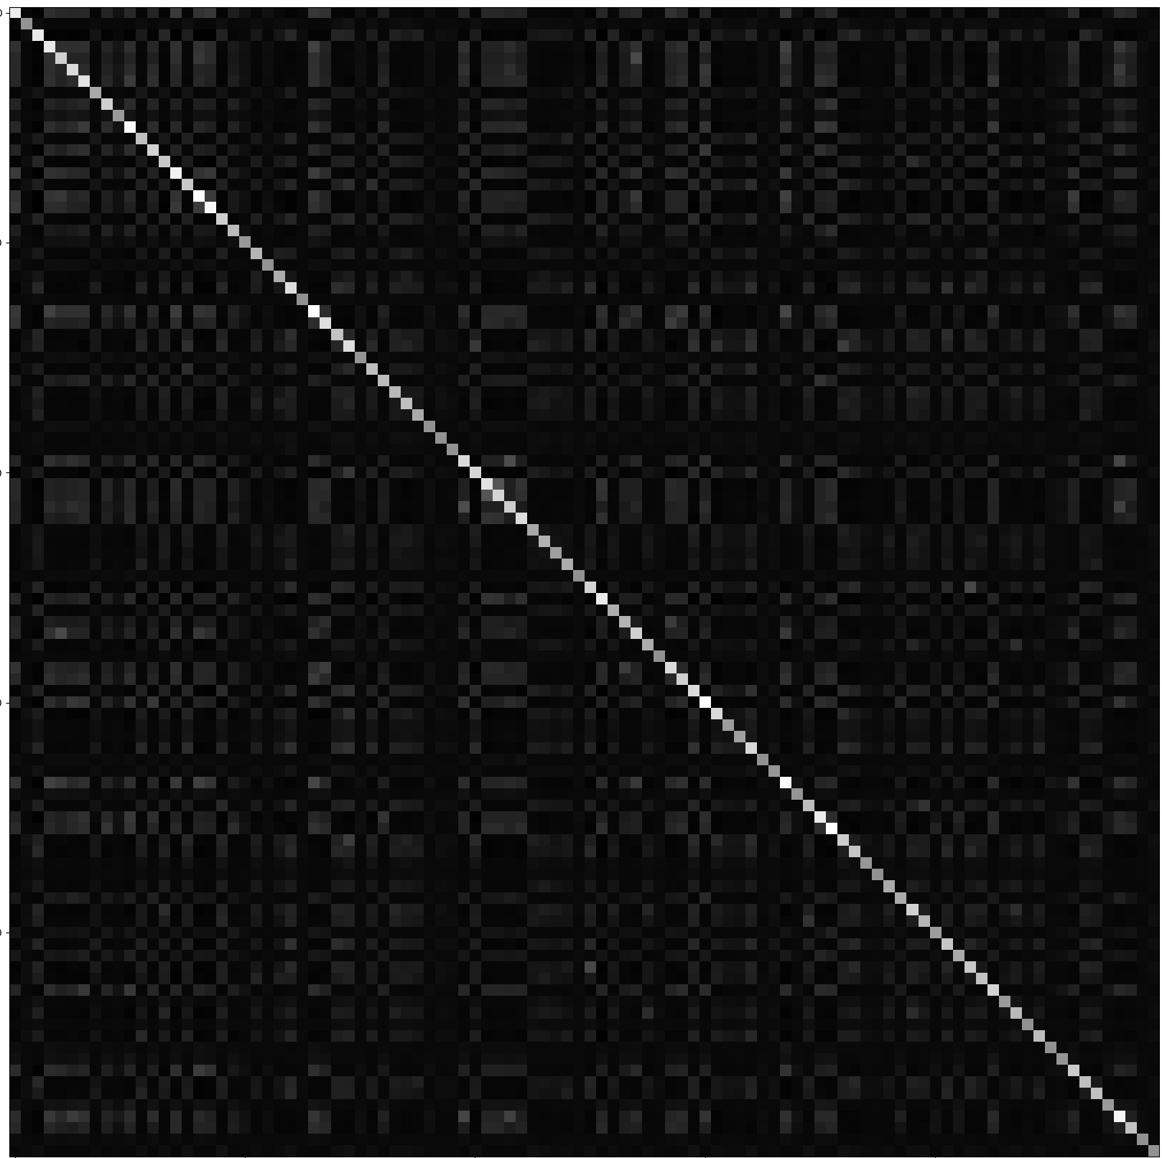

Turns out this is a tensorboard issue
WCxW
numerator
denumerator

Slide 6
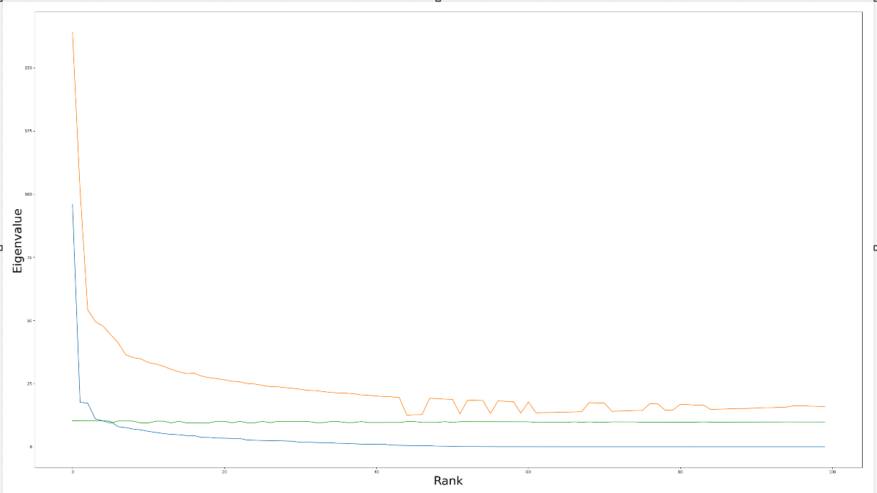
Blue = WCxW Yellow = C_z Green = C_zx

Slide 7
Patience experiments and failures
1- Control: 300 neurons, 18x18 pixels, DoG parametrization.
No patience
2- Failed #1: 300 neurons, 18x18 pixels, DoG parametrization.
Reduce LR by 50% if no improvement for 500 epochs: This was too strong, and LR was too low for learning to occur.
3- Failed #2: 300 neurons, 18x18 pixels
Reduce LR by 50% if no improvement for 50k epochs, with a 100k epochs cooldown. Set DoG parametrization to False.

Slide 8
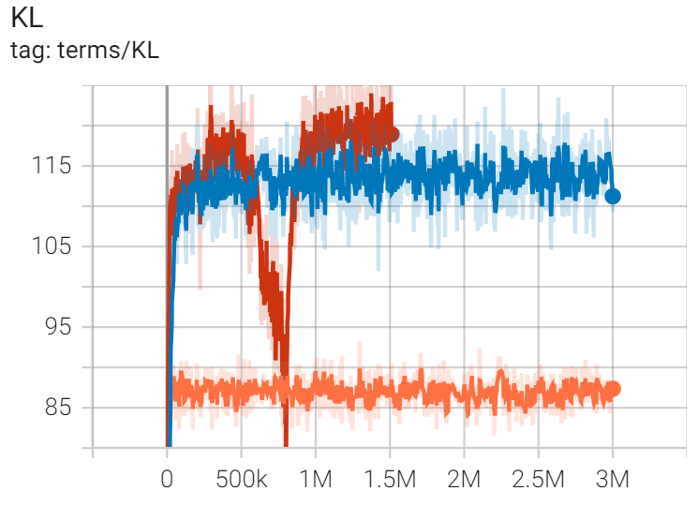
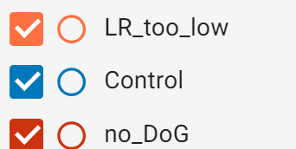
Show tensorboard

Slide 9
Reminder of how we classify mosaics
Do radial averages for each neuron
Do PCA on radial averages
Take first 3 PCs and do gaussian mixtures on these to get neuron types

Slide 10
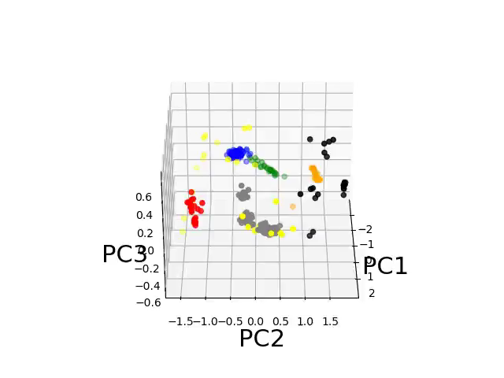
Classifying populations based on their first 3 PCs - Control

Slide 11

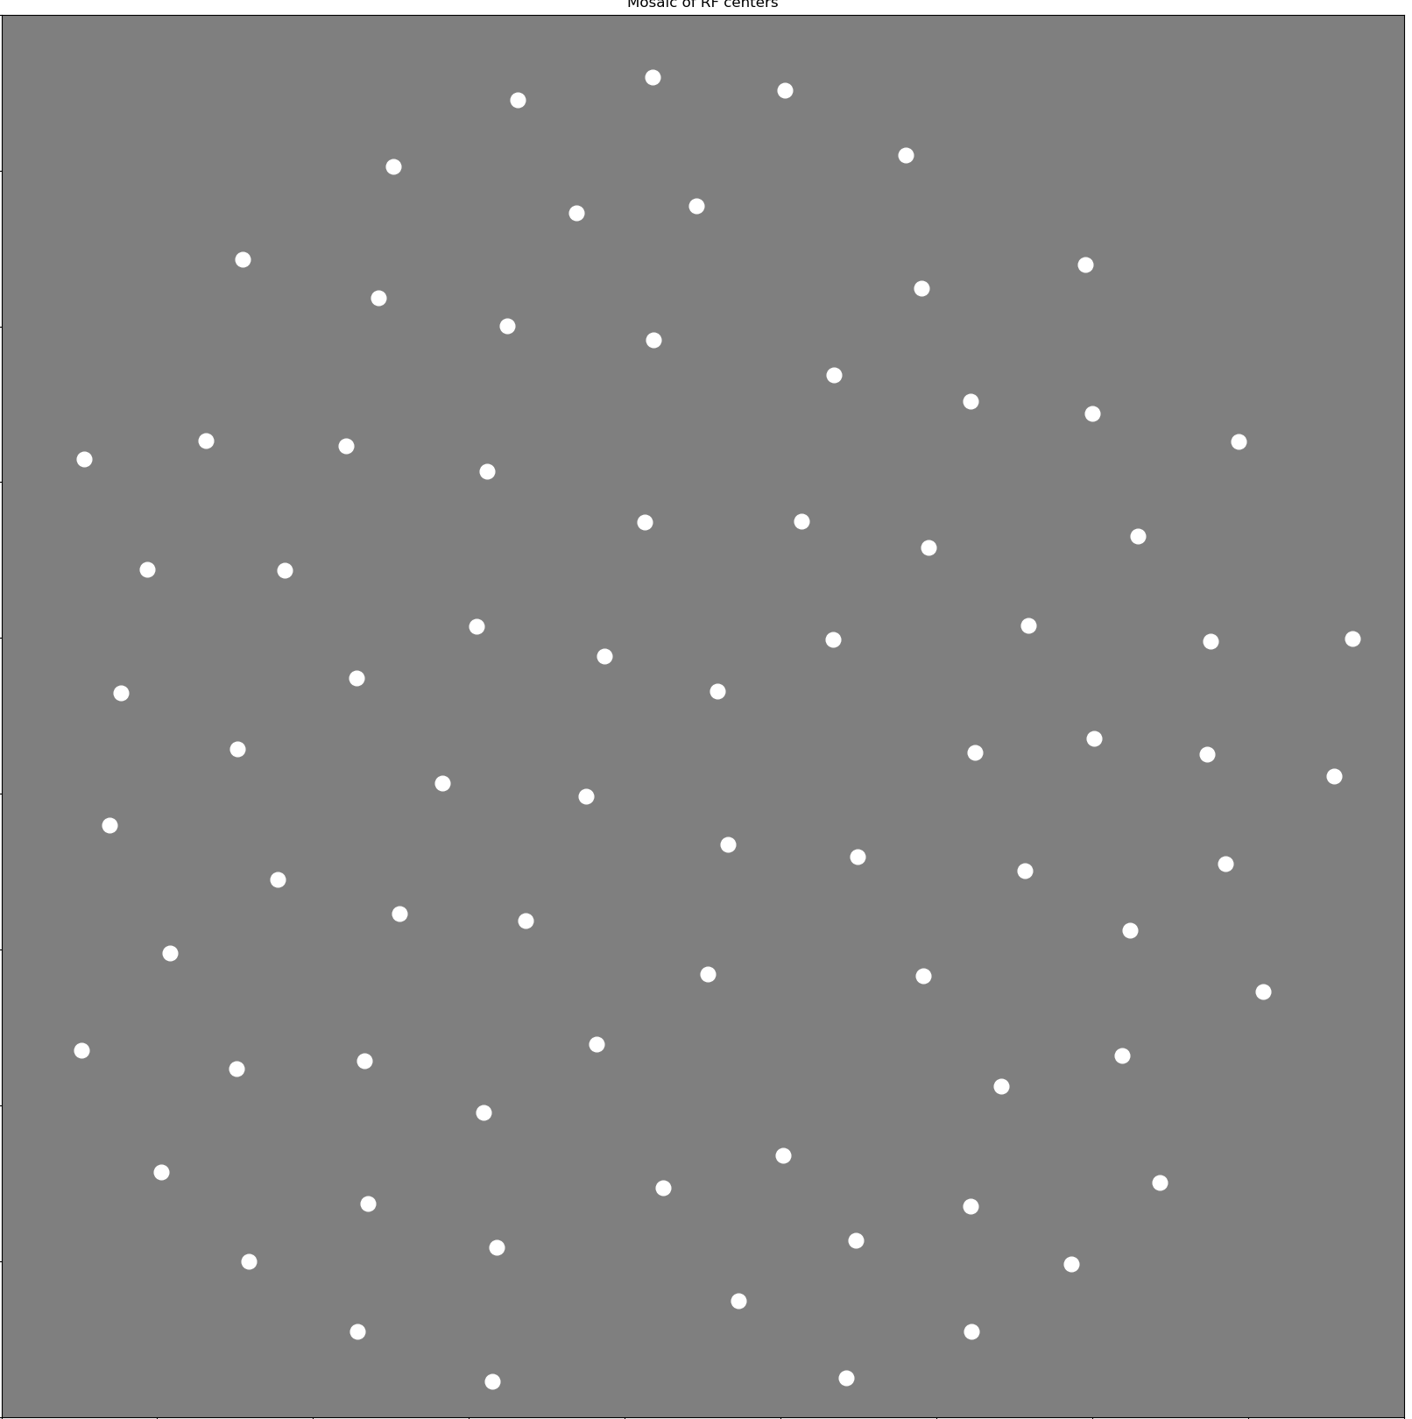
Some of these mosaics look good

Slide 12


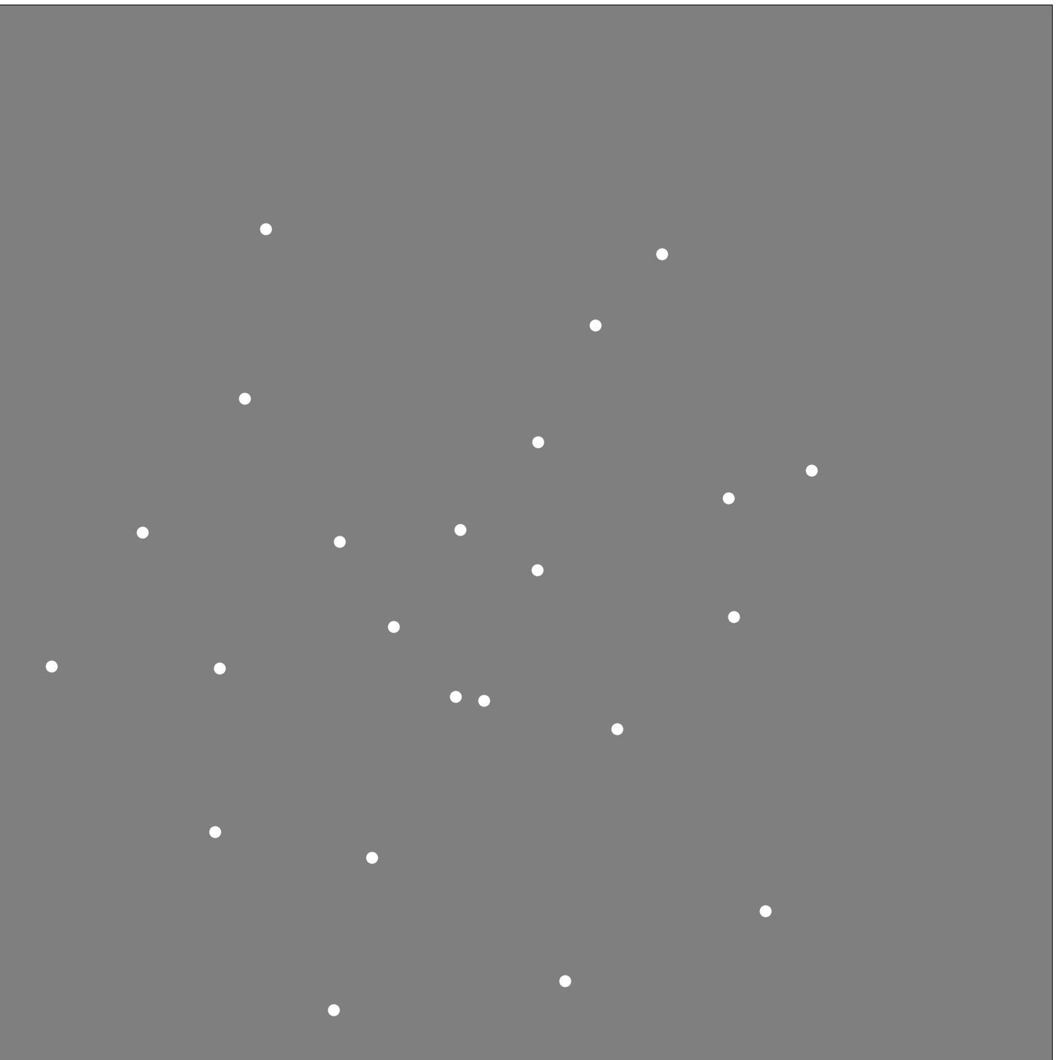
Others… not so good

Slide 13
Plan for next week
Do a successful run with patience
Figure out whether we get “bad” mosaics because classification is bad or because mosaics are bad

Slide 14
Question for John
I tried to plot det(C_z) and det(C_zx) over epochs.
However, when I compute det(C_z) or det(C_zx), I get inf???
Answer: Need to do the log of my inf number
Use logdet function*

